Slide 1
Measuring a lot lot of forces
With Dr. Chen’s Force Transducer
Eric Otrusina

Slide 2
What forces? What is a lot lot?
Dr. Chen brain mapping
Rabbits to humans
Reliable test method

Slide 3
I’m reliability
Something to hold the transducer
Must be easily repeated

Slide 4
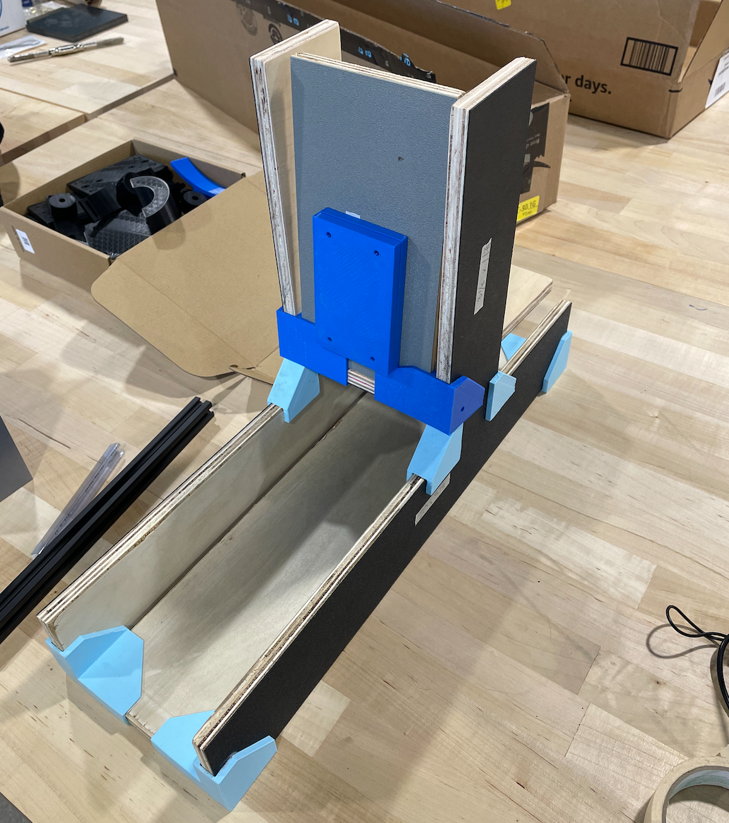
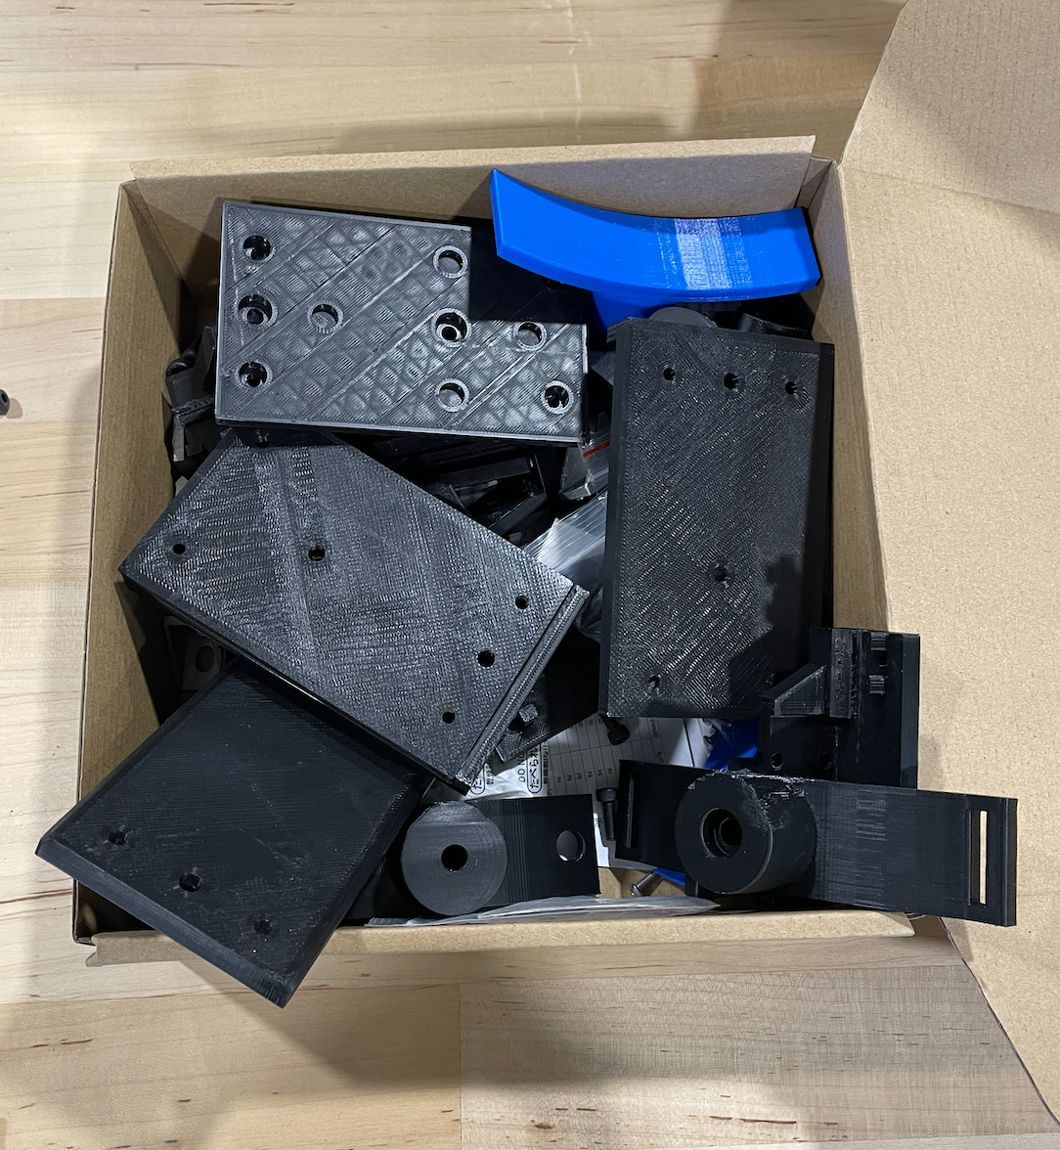

Slide 5
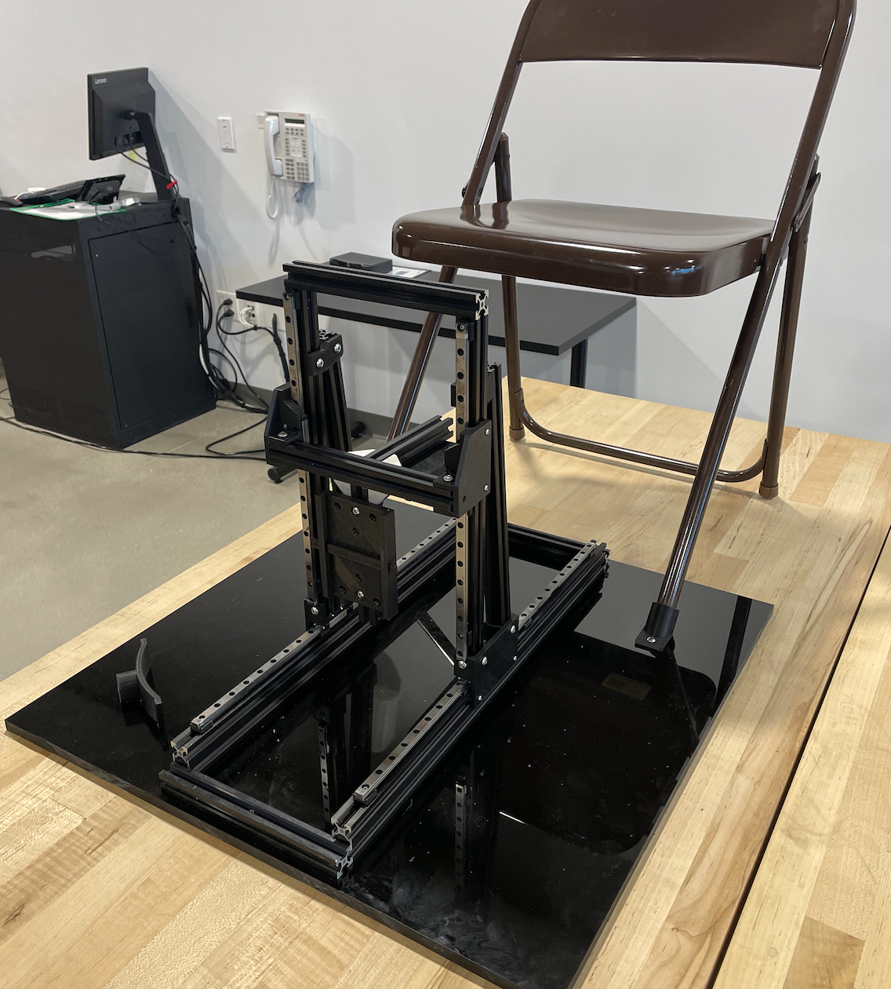
¿What now?
- Not sturdy enough
- Takes too long to set up
- Weird angles
- Chair interferes

Slide 6

solution
More money
Bigger and better 😎

